Slide 1
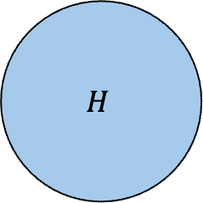
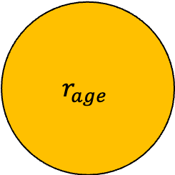
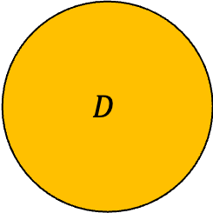
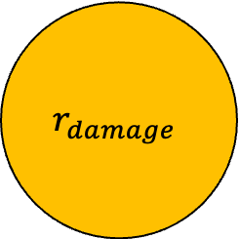
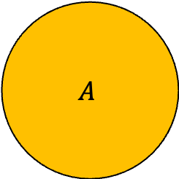
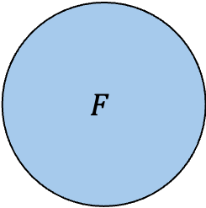
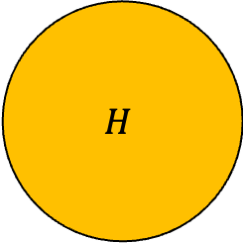
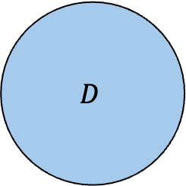
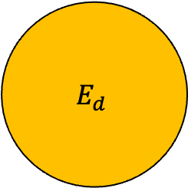
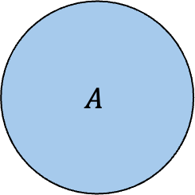
$$F$$
Component Dynamics Overview
Health = condition (damage/ wear-tear)
Age = lifecycle progress (time-based)
$$r_{damage}$$
$$H$$
$$H$$
$$r_{age}$$
$$A$$
$$A$$
$$E_{d}$$
$$D$$
$$D$$
HS -> Health State
8/9

Slide 2
Operational Context
Physical Component
Energy Component
Electrical Component
Electrical Component:
Status
Energy Component
Initial Charge
Charge Rate
Discharge Rate
Operational Context
Initial Charge
Charge Rate
Discharge Rate
8/11

Slide 3
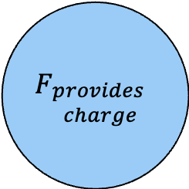
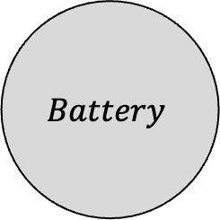
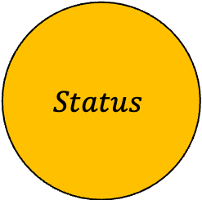
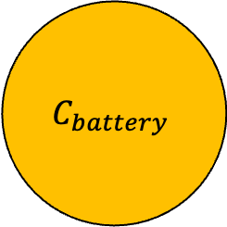
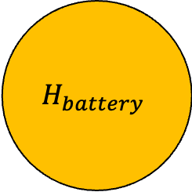
$$Status$$
$$F_{\begin{aligned}provides \\ charge\end{aligned}}$$
$$H_{battery}$$
$$Battery$$
$$C_{battery}$$

Slide 4
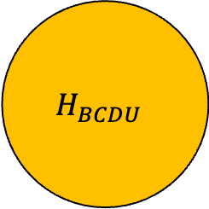
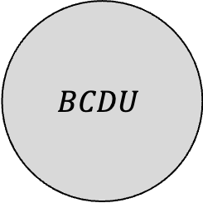
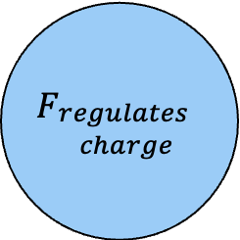
$$Status$$
$$H_{BCDU }$$
$$F_{\begin{aligned}provides \\ charge\end{aligned}}$$
$$BCDU$$
$$H_{battery}$$
$$Battery$$
$$F_{\begin{aligned}regulates \\ charge\end{aligned}}$$
$$C_{battery}$$
9/12

Slide 5

PFCS
ECU
RPCM
…
DDCU
Source
DCSU
MBSU
Nuclear Reactor
Source
.
.
.
BCDU
Main Dome
Batteries
Tunnel
Secondary Dome
Solar Arrays
8/26

Slide 6
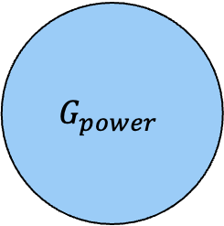

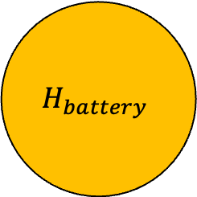
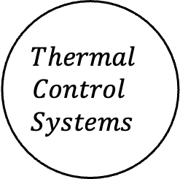
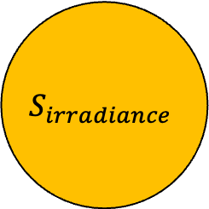
Solar Power
$$Thermal$$
$$Control$$
$$Systems$$
$$S_{irradiance}$$
$$G_{power}$$
$$H_{battery}$$
$$Solar Panels$$

